Slide 1
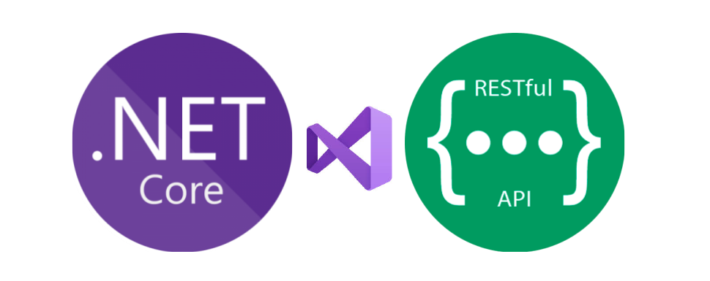
1
.NET Platform Overview

Slide 2
Syllabus
.NET Platform Overview
Introduction to .NET Core
Introduction to REST
Building RESTful APIs with ASP.NET Core
Data Access with EF Core
ASP.NET Core Security
Introduction to Docker
Dockerize ASP.NET Core Applications
Introduction to Microservices
Building Microservices with ASP.NET Core

Slide 3
Outline
.NET Platform Overview
.NET Implementations
.NET Standard
Runtimes and Class Libraries
Application Frameworks and Common Tooling
The Future of .NET

Slide 4
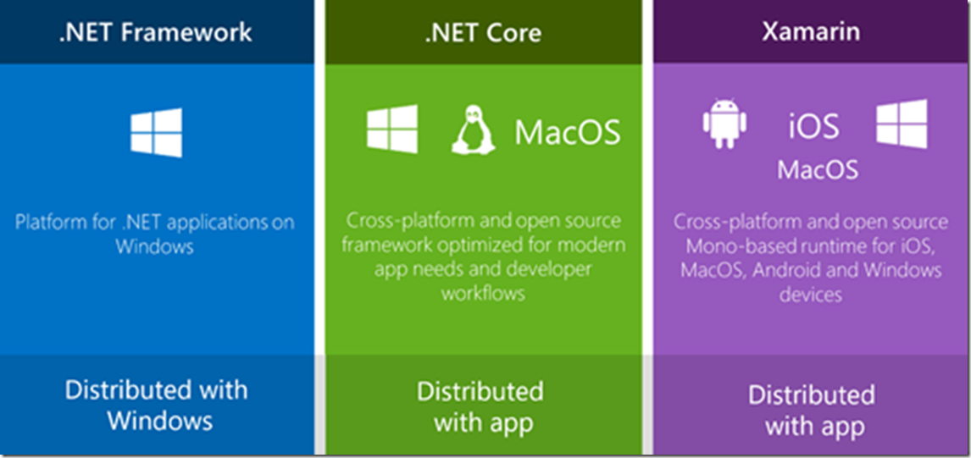
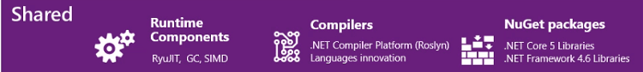
.NET Platform
Web and Desktop Applications
Web and Cloud Applications
Mobile Apps and Unity Games
Universal Windows Apps
UWP
Modern, touch-enabled Windows applications and software, targeting including PCs, tablets, phones, and Xbox.
Common Language Runtime (CLR)
Core Common Language Runtime (CoreCLR)
Xamarin.iOS, Xamarin.Android, Xamarin.Mac, Mono desktop
.NET Native
.NET Standard

Slide 5
.NET Implementations
There are four primary .NET implementations that Microsoft actively develops and maintains:
.NET Framework
.NET Core
Mono
UWP

Slide 6
.NET Framework
.NET Framework is the original .NET implementation that has existed since 2002.
.NET Framework is optimized for building Windows desktop applications.
Versions 4.5 and later implement .NET Standard, so code that targets .NET Standard can run on those versions of .NET Framework.

Slide 7
.NET Framework Release Timeline
Apr 2003 1.1
Included as part of Windows OS
Nov 2006 3.0 (WinFx)
WPF WCF WF
Apr 2010 4.0
TPL
Jul 2015 4.6
RyuJIT New 64bit JIT
Apr 2019 4.8
Final Version
Jan 2002 1.0
First Version
Jan 2006 2.0
Full 64bit support
Nov 2007 3.5
LINQ
Aug 2012 4.5
Async Await UWP .NET Standard
May 2017 4.7
4 Major Releases
4 Minor Releases

Slide 8
.NET Core
.NET Core is a cross-platform implementation of .NET and designed to handle server and cloud workloads at scale.
It runs on Windows, macOS, and Linux.
It implements the .NET Standard, so code that targets the .NET Standard can run on .NET Core.

Slide 9
.NET Core Release Timeline
Nov 2016 1.1
May 2018 2.1
Sep 2019 3.0
Nov 2020 5.0
Nov 2022 7.0
Jun 2016 1.0
Aug 2017 2.0
Dec 2018 2.2
Dec 2019 3.1
Nov 2021 6.0
3 Major Releases
Future Annual Releases

Slide 10
.NET Implementations
A .NET application is developed for and runs in one or more implementations of .NET.
There is an API specification common to all implementations of .NET that's called the .NET Standard.

Slide 11
.NET Runtimes
A runtime is the execution environment for a managed program.
The OS is part of the runtime environment but is not part of the .NET runtime.
Runtime | .NET Implementation
Common Language Runtime (CLR) | .NET Framework
Core Common Language Runtime (CoreCLR) | .NET Core
Xamarin.iOS, Xamarin.Android, Xamarin.Mac Mono desktop | Mono
.NET Native | UWP

Slide 12
.NET Class Libraries
Class libraries are the shared library concept for .NET.
They enable you to componentize useful functionality into modules that can be used by multiple applications.
Class libraries are described using the .NET Assembly file format.

Slide 13
.NET Tooling and Common Infrastructure
The .NET languages and their compilers
The .NET project system
MSBuild - the build engine used to build projects
NuGet - Microsoft's package manager for .NET

Slide 14
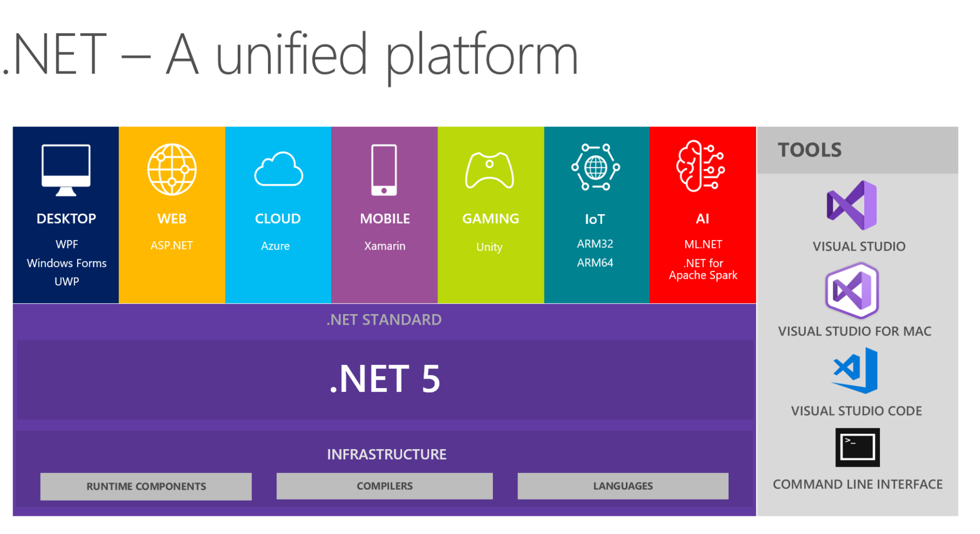
.NET

Slide 15
Summary
There are four primary .NET implementations that Microsoft actively develops and maintains: .NET Framework, .NET Core, Mono, and UWP.
.NET Standard is a formal specification of .NET APIs that are intended to be available on all .NET implementations.
.NET 5 is .NET Core VNext.

Slide 16
2
Introduction to .NET Core

Slide 17
Introduction to .NET Core
Cross Platform
Open Source
Modern
Built for High Performance
Consistent Across Environments
Command-Line Tools
Flexible Deployment

Slide 18
.NET Core CLI
The .NET Core command-line interface (CLI) is a cross-platform toolchain for developing, building, running, and publishing .NET Core applications.
The .NET Core CLI is included with the .NET Core SDK.

Slide 19

An introduction to NuGet
An essential tool for any modern development platform is a mechanism through which developers can create, share, and consume useful code.
Often such code is bundled into "packages" that contain compiled code (as DLLs) along with other content needed in the projects that consume these packages.
For .NET (including .NET Core), the Microsoft-supported mechanism for sharing code is NuGet, which defines how packages for .NET are created, hosted, and consumed, and provides the tools for each of those roles.

Slide 20
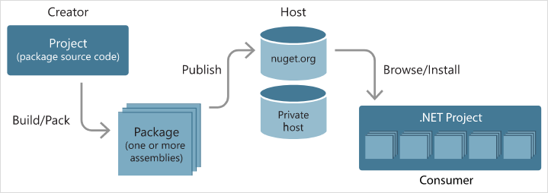
NuGet General Flow

Slide 21
NuGet Client Tools
To work with NuGet, as a package consumer or creator, you can use command-line interface (CLI) tools as well as NuGet features in Visual Studio:
dotnet.exe (.NET Core CLI)
nuget.exe CLI Tool for .NET Framework
Visual Studio NuGet Package Manager
https://docs.microsoft.com/en-us/nuget/install-nuget-client-tools

Slide 22
NuGet Configurations
NuGet's behavior is driven by the accumulated settings in one or more NuGet.Config (XML) files that can exist at project, user, and computer-wide levels.
A global NuGetDefaults.Config file also specifically configures package sources.
Settings apply to all commands issued in the CLI, the Package Manager Console, and the Package Manager UI.
https://docs.microsoft.com/en-us/nuget/consume-packages/configuring-nuget-behavior

Slide 23
Packages, Metapackages, and Frameworks
.NET Core is a platform made of NuGet Packages.
Some product experiences benefit from fine-grained definition of packages while others from coarse-grained.
To accommodate this duality, .NET Core is distributed as a fine-grained set of packages and in coarser chunks with a package type informally called a Metapackage.
Each of the .NET Core packages supports being run on multiple .NET implementations, represented as Frameworks.

Slide 24
Packages
.NET Core is split into a set of packages that provide primitives, higher-level data types, app composition types, and common utilities.
Each of these packages represents a single assembly of the same name.
For example, the System.Runtime package contains System.Runtime.dll.

Slide 25
4
Building RESTful APIs with ASP.NET Core

Slide 26
Outline
ASP.NET Core Ecosystem
Startup class
Dependency Injection
Middleware
Host
Servers
Configurations
Options Pattern
Environments
Logging

Slide 27
ASP.NET Core Overview
ASP.NET Core is a cross-platform, high-performance, open-source framework for building modern, cloud-enabled, Internet-connected apps.
Build web apps and services, Internet of Things (IoT) apps, and mobile backends.
Use your favorite development tools on Windows, macOS, and Linux.
Deploy to the cloud or on-premises.

Slide 28
ASP.NET Core Benefits
A unified story for building web UI and web APIs.
A lightweight, high-performance, and modular HTTP request pipeline.
Architected for testability.
A cloud-ready, environment-based configuration system.
Built-in dependency injection.
Flexible deployment and to host.

Slide 29
ASP.NET Core Ecosystem
Sites
Services
Razor Page
MVC
Blazor
Web API
SignalR
gRPC
ASP.NET Core

Slide 30
ASP.NET Core Web API
You can use ASP.NET Core Web API Apps, to build RESTful HTTP services.

Slide 31
ASP.NET Core Web API Features
Built-in support for Content Negotiation
Model Binding and Formatting
Model Validation

Slide 32
Startup Class
The Startup class is where:
Services required by the app are configured.
The app's request handling pipeline is defined, as a series of middleware components.

Slide 33
Dependency Injection
ASP.NET Core includes a built-in dependency injection (DI) framework that makes configured services available throughout an app.
Services are typically resolved from DI using constructor injection. With constructor injection, a class declares a constructor parameter of either the required type or an interface.

Slide 34
Middleware
The request handling pipeline is composed as a series of middleware components.
Each component performs operations on an HttpContext and either invokes the next middleware in the pipeline or terminates the request.
ASP.NET Core includes a rich set of built-in middleware.
Custom middleware components can also be written.

Slide 35
Host
On startup, an ASP.NET Core app builds a host.
The host encapsulates all of the app's resources, such as:
An HTTP server implementation
Middleware components
Logging
Dependency injection (DI) services
Configuration

Slide 36
Host
There are two different hosts:
.NET Generic Host
ASP.NET Core Web Host
The .NET Generic Host is recommended. The ASP.NET Core Web Host is available only for backwards compatibility.

Slide 37
Servers
An ASP.NET Core app uses an HTTP server implementation to listen for HTTP requests.
The server surfaces requests to the app as a set of request features composed into an HttpContext.

Slide 38
Servers
Kestrel is a cross-platform web server. Kestrel is often run in a reverse proxy configuration using IIS. In ASP.NET Core 2.0 or later, Kestrel can be run as a public-facing edge server exposed directly to the Internet.
IIS HTTP Server is a server for Windows that uses IIS. With this server, the ASP.NET Core app and IIS run in the same process.

Slide 39
Configurations
ASP.NET Core provides a configuration framework that gets settings as name-value pairs from an ordered set of configuration providers.
Built-in configuration providers are available for a variety of sources, such as .json files, .xml files, environment variables, and command-line arguments.
By default, ASP.NET Core apps are configured to read from appsettings.json, environment variables, the command line, and more.

Slide 40
Options Pattern
The preferred way to read related configuration values is using the options pattern.

Slide 41
Environments
Execution environments, such as Development, Staging, and Production, are a first-class notion in ASP.NET Core.
Specify the environment an app is running in by setting the ASPNETCORE_ENVIRONMENT environment variable.
ASP.NET Core reads during startup and stores the value in an IWebHostEnvironment implementation, and makes it available anywhere in an app via dependency injection (DI).

Slide 42
Logging
ASP.NET Core supports a logging API that works with a variety of built-in and third-party logging providers:
Console
Debug
Event Tracing on Windows
Windows Event Log
TraceSource
Azure App Service
Azure Application Insights

Slide 43
Routing
A route is a URL pattern that is mapped to a handler.
The handler is typically an action method in an MVC controller, or a middleware.
ASP.NET Core routing gives you control over the URLs used by your app.

Slide 44
Error Handling
ASP.NET Core has built-in features for handling errors, such as:
A developer exception page
Custom error pages
Static status code pages
Startup exception handling

Slide 45
Content Negotiation
Dynamically determines the media type of a resource based on Client request:
Client sends Accept
Client sends Content-Type when sending data
Server response with Content-Type
Web API provide automatic content negotiation.
Implemented by ObjectResult.

Slide 46
Summary
With ASP.NET Core you can use Web API Apps, to build RESTful APIs.
Programming Model will allow you do to simple things in a simple way, but will also let you dig deeper and get more control.

